Slide 1
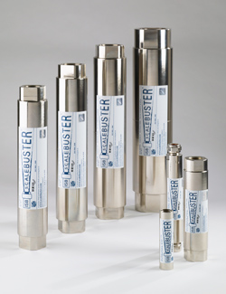
ScaleBuster Installation Guide
(ScaleBuster^{tm})
Solutions Limpides Inc. +1 450.531.9756 or Toll Free +1 855.378.4011
www.solutionslimpides.com

Slide 2
In your ScaleBusterTM Kit you will find
ScaleBusterTM Hydrodynamic reactor
A wire (yellow and green stripe) for the electrical bridge
Two stainless steel collars to connect the electrical bridge to the copper pipe before and after your ScaleBusterTM
Important Instructions
You must establish a copper section of 22.5’’ or 57 cm, at least, on each side of your ScaleBusterTM reactor.
With the two stainless steel collars included, you must connect the two copper sections one to the other with the green and the yellow wire included in order to establish an electrical bridge between the two ends of your assembly. (see diagram)
Afterward, with a copper wire of 14 or 12 gage, you connect one of the ends of the bridge to the ground. (Preferably using the ground of the pressure switch of your pumping system)

Slide 3
Safe grounding for plastic pipe (PEX) *If your plumbing is of copper or steel, it is not necessary to connect the ground of the copper pipe of your ScaleBuster to the pressure switch
PEX pipe
SharkBite sleeve
Pressure tank
Copper pipe 22.5’’ (56 cm.)
Electrical Bridge (with the yellow and green stripe wire included)
Ground wire connected to the ground of the pressure switch
Manostat
Copper pipe 22.5’’ (57 cm.)
PEX pipe

Slide 4
ScaleBusterTM Installed

